Slide 1
S.2 Select Subcommittee of the Medical Affairs Committee April 28, 2021

Slide 2
DHEC’s Role
Mission: To improve the quality of life for all South Carolinians by promoting and protecting the health of the public and the environment
Vision: Healthy people living in healthy communities

Slide 3
DHEC Overview
South Carolina’s public health and environmental protection agency
Oversight by the DHEC Board
Operation and management provided by a Director and an Executive Leadership Team
A centralized structure with four regions managing operations in all 46 counties

Slide 4
DHEC by the Numbers
DHEC Team
Current staffing
3,531 full time equivalents
804 hourly
104 temporary grant and time-limited
Operating 105 facilities in all 46 counties across the state
Legal Responsibilities
DHEC legal responsibilities currently touch on more than 360 state and federal statutes, regulations and state provisos

Slide 5
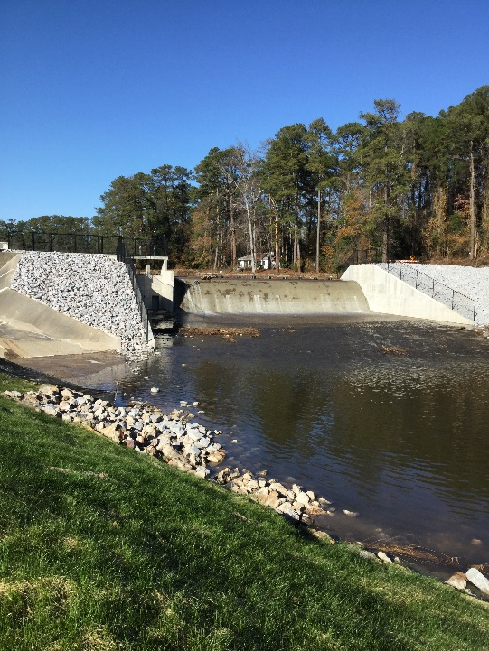
Day-to-Day Operations
DHEC in an average year:
Environmental Affairs
Over 50,000 active environmental permits
Nearly 100,000 environmental inspections
24,511 environmental health complaints investigated
On average 2,300 dams subject to regulation
OCRM preserves sensitive and fragile areas while promoting responsible development in our state’s 8 coastal counties

Slide 6
Day-to-Day Operations
Healthcare Quality
Over 2,000 healthcare facilities and services inspected and investigated
Over 12,000 licensed and certified health professionals
25,788 Prescription Monitoring Program (PMP) users registered
Oversight of many types of facilities, services, and providers, including:
hospitals | controlled substances | EMS | radioactive materials
nursing homes | tattoo facilities | athletic trainers | medical labs
assisted living facilities | body piercing facilities | x-ray machines
hospice | home health | tanning beds

Slide 7
Day-to-Day Operations
Public Health
Over half a million clinical client encounters in our local health departments
Hundreds of acute disease outbreak investigations conducted
Tens of thousands of reports of acute diseases reviewed
Over 3 million public health laboratory tests performed
More than a quarter million birth and death records filed
COVID-19 - oversight of 7 million tests and close to 3 million vaccinations

Slide 8
Improving the Future of Public Health and the Environment in South Carolina
DHEC is committed to providing timely, relevant facts, knowledge and insights to policymakers
This includes helping ensure we are serving the best interest of all South Carolinians through sound science and stakeholder input
Several options have been proposed to best serve South Carolina
Current structure
S 2
Others

Slide 9
Current Model: Health and Environmental Control in One Agency
DHEC is structured to support an integrated response mutually beneficial to health and safety of people and environment
Major events/outbreaks:
Everyday responses:
COVID-19 | Hurricanes/natural disasters | Statewide Hepatitis A outbreak
Train derailments | 2017 Zika Virus response | Hazardous substance releases
Landfill fires | Train derailments
Lead exposures | Food-borne illnesses | Harmful algal blooms
Rabies incidents | Vector-borne illnesses | Drinking water emergencies
Radiation protection | Sanitary sewer overflows

Slide 10
Current Model: Health and Environmental Control in One Agency
Our environment is a critical determinant of our health
Policy decisions on environmental matters can have a profound impact on public health. DHEC’s current structure:
facilitates inclusive, cross-sector decision-making among our public health and environmental experts
eases data sharing to monitor environmental quality and risk factors impacting chronic disease
is a powerful tool for rapid response to emergencies (COVID, hurricanes, hepatitis A, radiological)
eases administrative burden (and cost) through the sharing of complex technologies and large data monitoring tools

Slide 11
S. 2 – Separate Health and Environmental Agencies
Combines mental health, public health, healthcare quality, and substance abuse
Mental health and substance abuse are two top public health concerns
Promotes synergies across agencies that provide health services to the people of South Carolina
Supports further coordination of efforts
Consolidates resources

Slide 12
S. 2 – Separate Health and Environmental Agencies
Establishes a stand-alone environmental control agency
Emphasizes the importance of environmental protection in a new prominent way
Holistic approach to management of water resources (combined planning and regulatory functions)

Slide 13
Planning Considerations
Substantial transition planning will be needed to support infrastructure, budgets, programming, etc.
Certain programs with strong coordination and topical overlap:
Disease Control (COVID-19, Hepatitis A, Rabies, Foodborne Outbreaks, Vector-Borne Diseases, etc.)
Radiological Health
Childhood Lead Exposure
Laboratory Support Services
Hurricane Disaster Preparedness and Response
Many DHEC administrative functions are fully integrated at the enterprise level

Slide 14
Task Force to Strengthen the Health and Promote the Environment of S.C.
Helping to SHaPE a better future of health and environmental services for all South Carolinians

Slide 15
SHaPE SC
Brings together a cross-section of diverse stakeholders from across the state to review and provide strategic guidance on the future of DHEC
The task force will be charged with:
Evaluating current and potential structure responsibilities
Making recommendations to the Board and the Legislature based on their evaluation
Our goal: Improving the quality of life for all South Carolinians by promoting and protecting the health of the public and the environment

Slide 16
SHaPE SC Next Steps and Estimated Timeline
Approved by the Board this month
Committee members to include healthcare services, industry representatives, advocacy groups, state and local officials, and community stakeholders.
Estimated Timeline:
Aim is to schedule the first meeting for next month
Presentation and report to the Board and Legislature by late fall 2021

Slide 17
Edward D. Simmer, MD, MPH, DFAPA Director S.C. Dept. of Health & Environmental Control
Email: Edward.simmer@dhec.sc.gov
Buck Wilson
Legislative Affairs
S.C. Dept. of Health & Environmental Control
Email: wilsonbl@dhec.sc.gov

